Slide 1
Whiz Wheel Illustrated Instructions
Dr. Brad Burchett
Visiting Professor of Astronautics

Slide 2
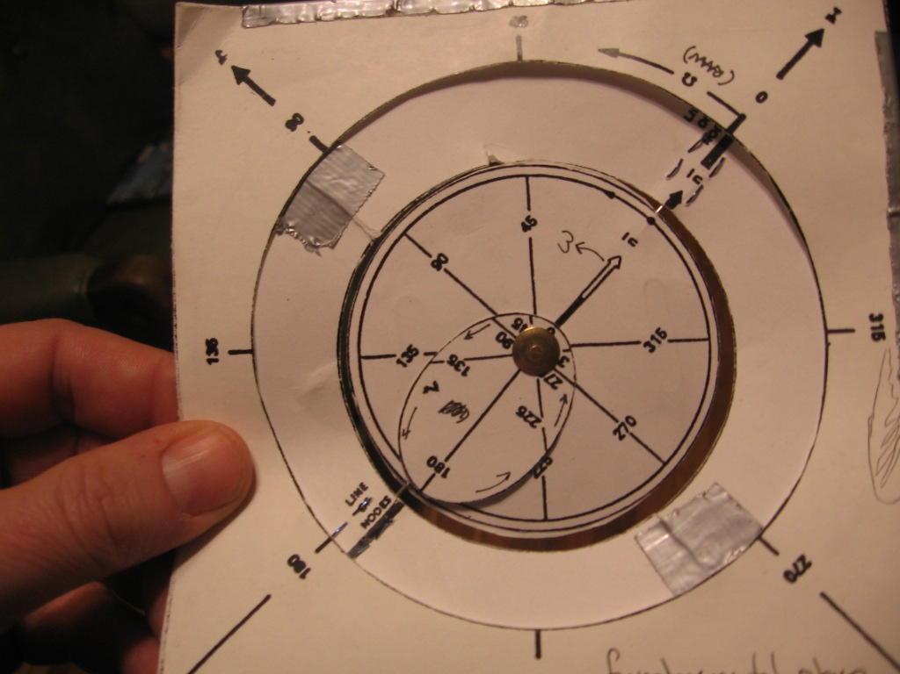
I vector
Earth
n vector
Equatorial
Plane
This is how the whiz wheel looks when properly assembled
  Note n vector aligned with fundamental axis (I or Aries)

Slide 3
Orbital plane
RAAN
markings
Perigee
True anomaly
markings
Argument of
Perigee
markings
Apogee
More terms defined

Slide 4
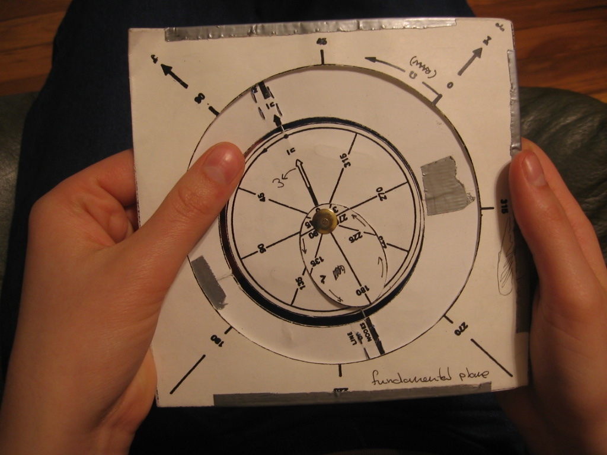
Dial in RAAN (Ω) by turning the ring (equatorial plane) in the specified direction.

Slide 5
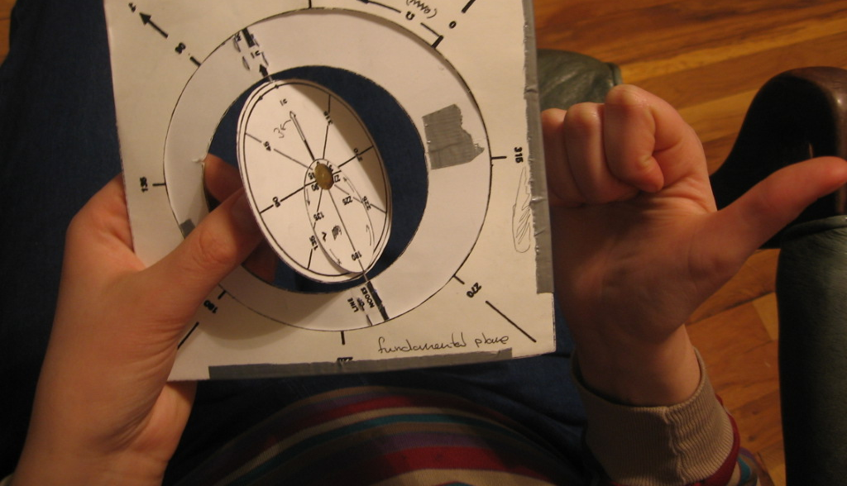
Ascending
Node
Direction of
flight
Tilt the orbital plane to set inclination (i). Note that the ascending node corresponds to the n vector drawn on orbital plane.
  Note: keep track of satellite direction of motion by imagining h vector pointing out of brad head (right thumb), then fingers of your right hand would curl in the direction of flight.

Slide 6
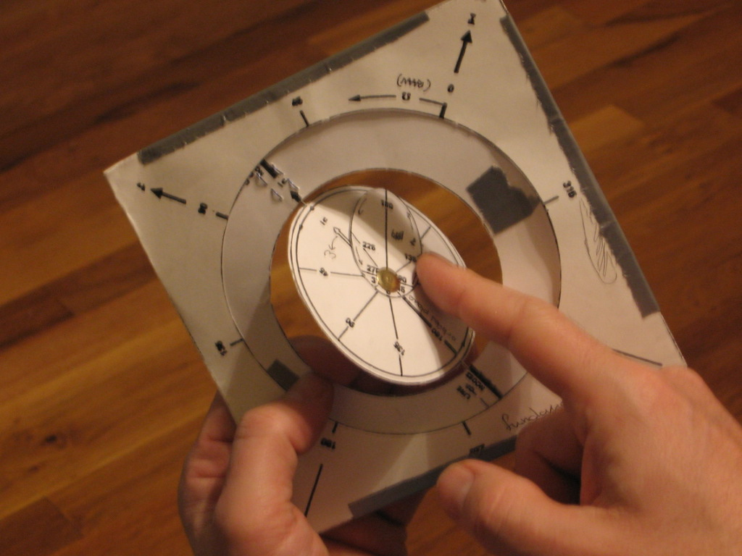
Argument of
Perigee
(135 deg in
This example)
Turn the orbit ellipse in the indicated direction to set argument of perigee.

Slide 7
True anomaly
Marked on
ellipse
Now satellite position can be visualized by applying true anomaly within the orbital ellipse.

Slide 8
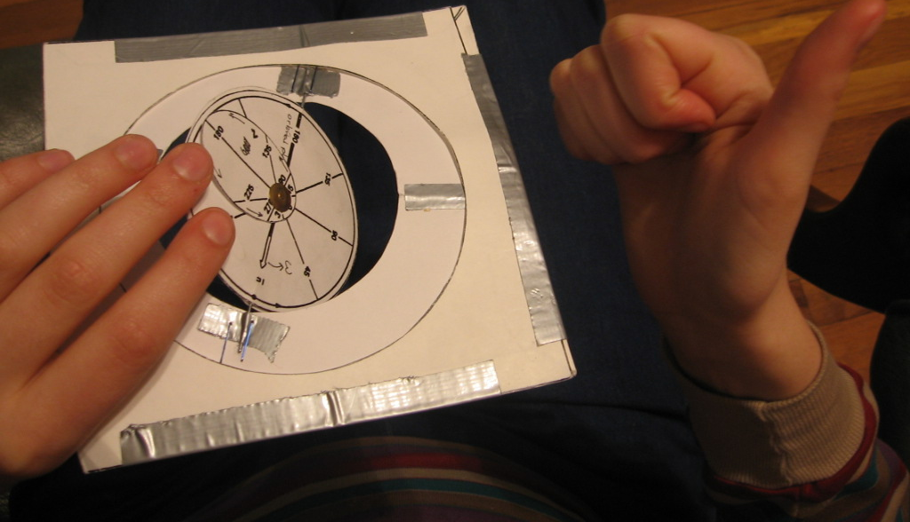
For retrograde orbits, the orbital ellipse will be ‘underneath’ the equatorial plane

Slide 9
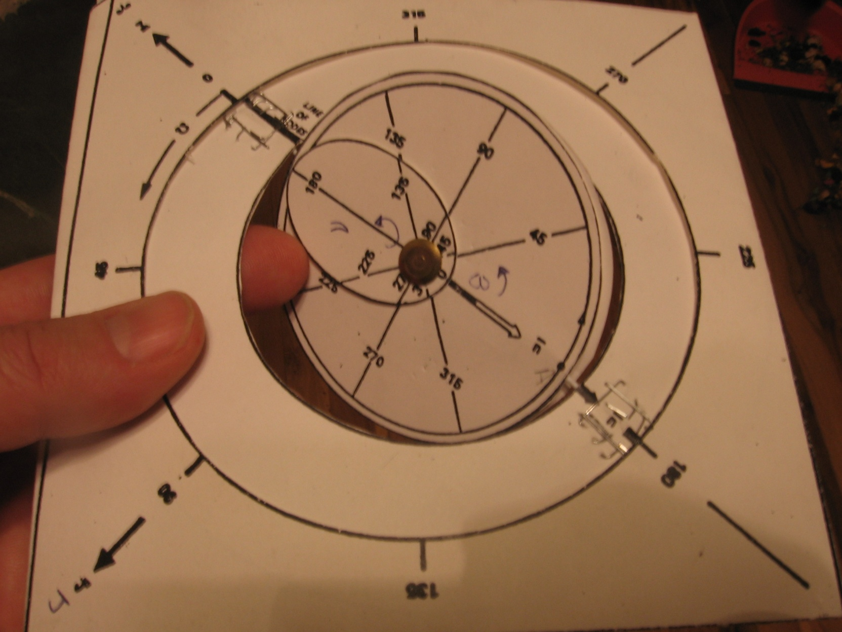
Illustrated examples
i=30°, Ω=180°, ω=0°, ν=180°

Slide 10
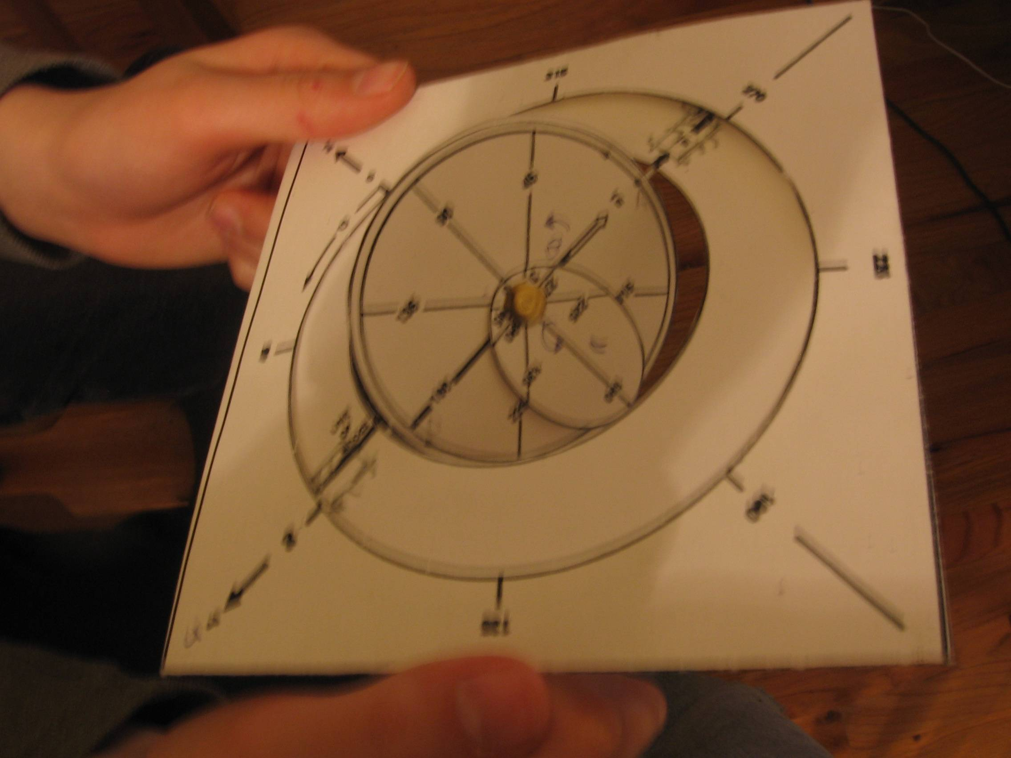
i=90°, Ω=270°, ω=90°, ν=90°

